Slide 1
Analyzing Systems Using Data Dictionaries
8
Systems Analysis and Design, 8e
Kendall & Kendall

Slide 2
Learning Objectives
Understand analysts use of data dictionaries for analyzing data-oriented systems.
Create data dictionary entries for data processes, stores, flows, structures, and logical and physical elements of the systems being studied, based on DFDs.
Understand the concept of a repository for analysts’ project information and the role of CASE tools in creating them.
Recognize the functions of data dictionaries in helping users update and maintain information systems.
Kendall & Kendall Copyright © 2011 Pearson Education, Inc. Publishing as Prentice Hall
8-<number>

Slide 3
Cataloging
Data flow diagrams can be used to catalog:
  Data processes
  Flows
  Stores
  Structures
  Elements
Cataloging takes place with the data dictionary
Kendall & Kendall Copyright © 2011 Pearson Education, Inc. Publishing as Prentice Hall
8-<number>
Notes:
The data dictionary is another method to aid in the analysis of data-oriented systems.
Using a top-down approach, the systems analyst uses data flow diagrams to begin compiling a data dictionary.

Slide 4
Major Topics
The data dictionary
The data repository
Defining data flow
Defining data structures
Defining data elements
Defining data stores
Using the data dictionary
XML
Kendall & Kendall Copyright © 2011 Pearson Education, Inc. Publishing as Prentice Hall
8-<number>

Slide 5
The Data Dictionary
A reference work of data about data (metadata)
Collects and coordinates data terms, and confirms what each term means to different people in the organization
Kendall & Kendall Copyright © 2011 Pearson Education, Inc. Publishing as Prentice Hall
8-<number>
Notes:
One reason to maintain a data dictionary is to keep consistent data.
Automated data dictionaries allow for the cross referencing of data items, allowing necessary program changes to all programs sharing a common element.

Slide 6
Need for Understanding the Data Dictionary
Provide documentation.
Eliminate redundancy.
Validate the data flow diagram.
Provide a starting point for developing screens and reports.
Determine the contents of data stored in files.
To develop the logic for DFD processes.
Create XML.
Kendall & Kendall Copyright © 2011 Pearson Education, Inc. Publishing as Prentice Hall
8-<number>
Notes:
Understanding what data compose a data dictionary, the conventions used in data dictionaries, and how a data dictionary is developed, are issues that remain pertinent for the system analyst during the systems effort.

Slide 7
The Data Repository
A data repository is a large collection of project information.
It includes:
  Information about the data maintained by the system
  Procedural logic and use cases
  Screen and report design
  Data relationships
  Project requirements and final system deliverables
  Project management information
Kendall & Kendall Copyright © 2011 Pearson Education, Inc. Publishing as Prentice Hall
8-<number>
Notes:
The data dictionary contains information about data and procedures; the repository is a larger collection of project information.
Information about the data maintained by the system – data flows, data stores, record structures,, elements, entities, and messages.
Project management information – delivery schedules, achievements, issues that need resolving, project users.

Slide 8
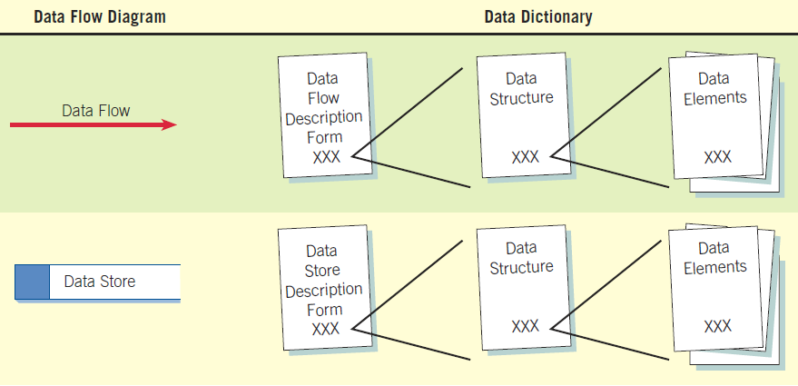
How Data Dictionaries Relate to Data Flow Diagrams (Figure 8.1)
Kendall & Kendall Copyright © 2011 Pearson Education, Inc. Publishing as Prentice Hall
8-<number>
Notes:
The data dictionary is created by examining and describing the contents of the data flows, data stores, and processes.

Slide 9
Data Dictionary Categories
Data flows
Data structures
Elements
Data stores
Kendall & Kendall Copyright © 2011 Pearson Education, Inc. Publishing as Prentice Hall
8-<number>
Notes:
The four data dictionary categories should be developed to promote understanding of the data of the system.

Slide 10
Defining the Data Flow
ID—identification number
Unique descriptive name
A general description of the data flow
The source of the data flow
The destination of the data flow
Type of data flow
The name of the data structure describing the elements
The volume per unit time
An area for further comments and notations
Kendall & Kendall Copyright © 2011 Pearson Education, Inc. Publishing as Prentice Hall
8-<number>
Notes:
The source of the data flow - This could be an external entity, a process, or a data flow coming from a data store.
Type of data flow:
A record entering or leaving a file.
Containing a report, form, or screen.
Internal - used between processes.
The volume per unit time - This could be records per day or any other unit of time.

Slide 11
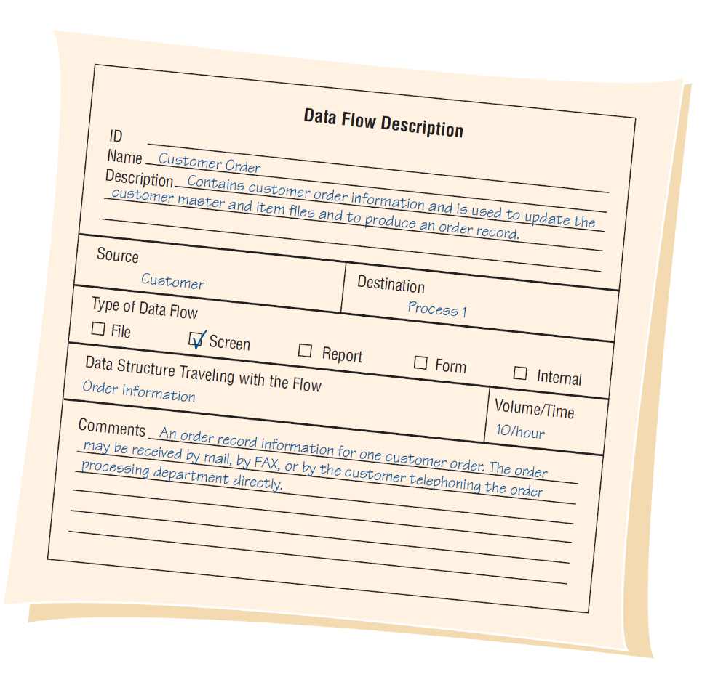
An Example of a Data Flow Description from World’s Trend Catalog Division (Figure 8.3)
Kendall & Kendall Copyright © 2011 Pearson Education, Inc. Publishing as Prentice Hall
8-<number>
Notes:
Represents the screen used to add a new CUSTOMER ORDER and to update the customer and item files.

Slide 12
Describing Data Structures
Data structures are made up of smaller structures and elements.
An algebraic notation is used to describe data structures.
Kendall & Kendall Copyright © 2011 Pearson Education, Inc. Publishing as Prentice Hall
8-<number>
Notes:
A record structure would be an example of a data structure.

Slide 13
Algebraic Notation
Equal sign, meaning “is composed of”
Plus sign, meaning “and”
Braces {} meaning repetitive elements
Brackets [] for an either/or situation
Parentheses () for an optional element
Kendall & Kendall Copyright © 2011 Pearson Education, Inc. Publishing as Prentice Hall
8-<number>
Notes:
Repetitive elements are also called repeating groups or tables.
Brackets – the elements listed between the brackets are mutually exclusive.
Parentheses – optional elements may be left blank on entry screens and may contain spaces or zeros for numeric fields in file structures.

Slide 14
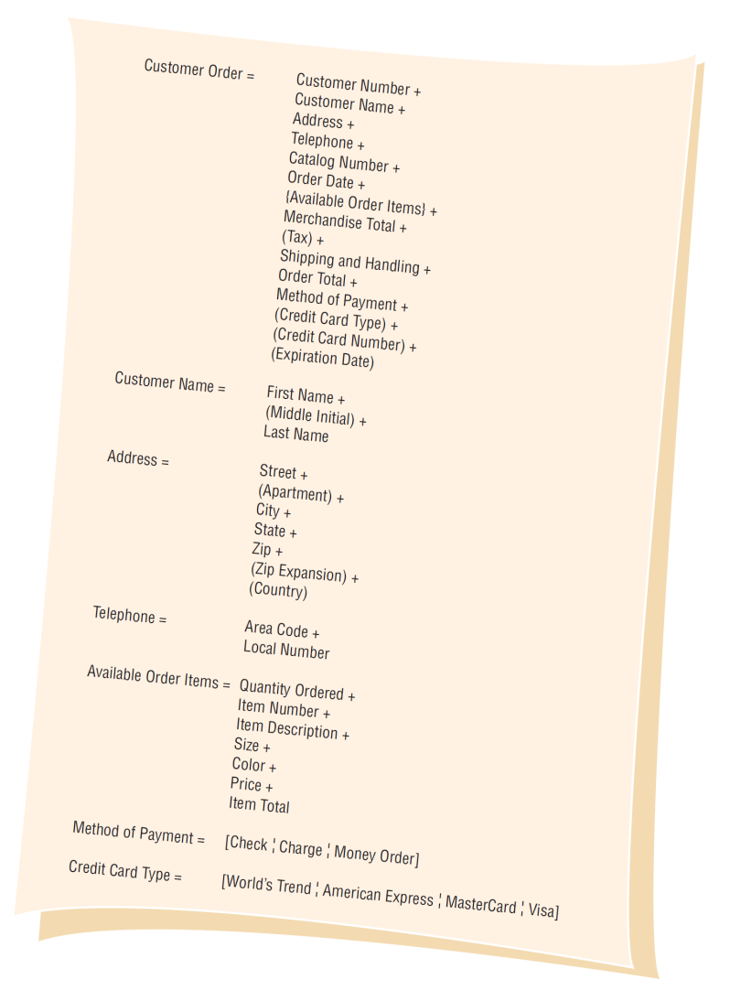
Data Structure Example for Adding a Customer Order at World’s Trend Catalog Division (Figure 8.4)
Kendall & Kendall Copyright © 2011 Pearson Education, Inc. Publishing as Prentice Hall
8-<number>

Slide 15
Structural Records
A structure may consist of elements or structural records.
These are a group of elements, such as:
  Customer name
  Address
  Telephone
Each of these must be further defined until they are broken down into their component elements.
Kendall & Kendall Copyright © 2011 Pearson Education, Inc. Publishing as Prentice Hall
8-<number>
Notes:
A structural record is made up of a group of element. Customer Name is made up of First Name, Middle Name, Last Name.

Slide 16
Structural Records Used in Different Systems
Structural records and elements that are used within many different systems are given a non-system-specific name, such as street, city, and zip.
The names do not reflect a functional area.
This allows the analyst to define them once and use in many different applications.
Kendall & Kendall Copyright © 2011 Pearson Education, Inc. Publishing as Prentice Hall
8-<number>
Notes:
For example, City may be a customer city, supplier city, or employee city.

Slide 17
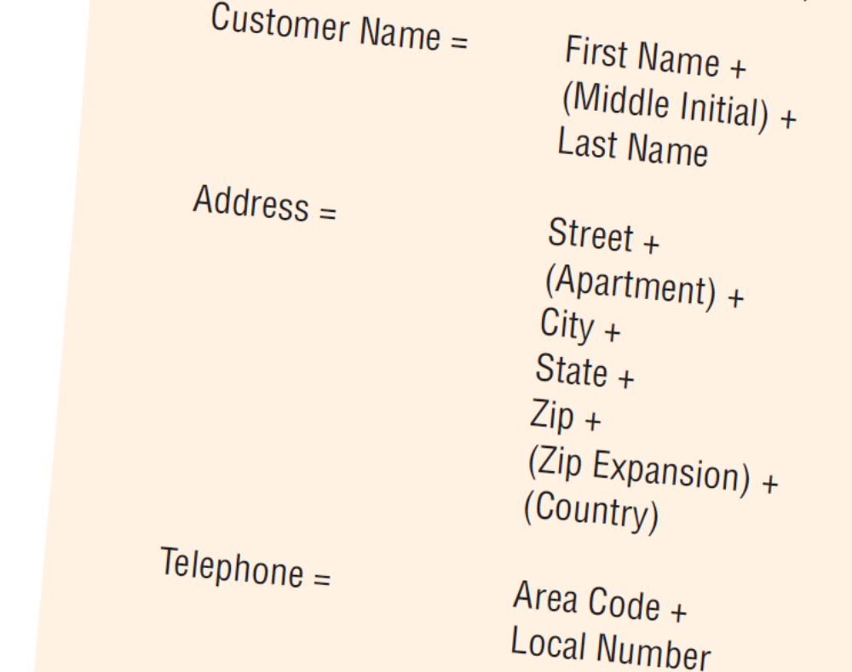
Structural Record Example
Kendall & Kendall Copyright © 2011 Pearson Education, Inc. Publishing as Prentice Hall
8-<number>
Notes:
Customer name, address, and telephone are groups of elements or structural records.

Slide 18
Logical and Physical Data Structures
Logical:
  Show what data the business needs for its day-to-day operations.
Physical:
  Include additional elements necessary for implementing the system.
Kendall & Kendall Copyright © 2011 Pearson Education, Inc. Publishing as Prentice Hall
8-<number>
Notes:
It is important that the logical design accurately reflect the mental model of how the user views the system.
The physical data structures are designed using the logical data structures as a basis.

Slide 19
Physical Data Structures
Key fields used to locate records
Codes to identify record status
Transaction codes to identify different record types
Repeating group entries
Limits on items in a repeating group
Password
Kendall & Kendall Copyright © 2011 Pearson Education, Inc. Publishing as Prentice Hall
8-<number>
Notes:
Key fields used to locate records – An example is an item number, its not required for a business to function but is necessary for identifying and locating computer records.
Codes to identify record status – such as whether an employee is active or inactive.
Transaction codes to identify different record types – a credit file containing records for returned items as well as records of payments.
Repeating group entries – contain a count of how many items are in the group
Password – might be used by a customer accessing a secure Web site.

Slide 20
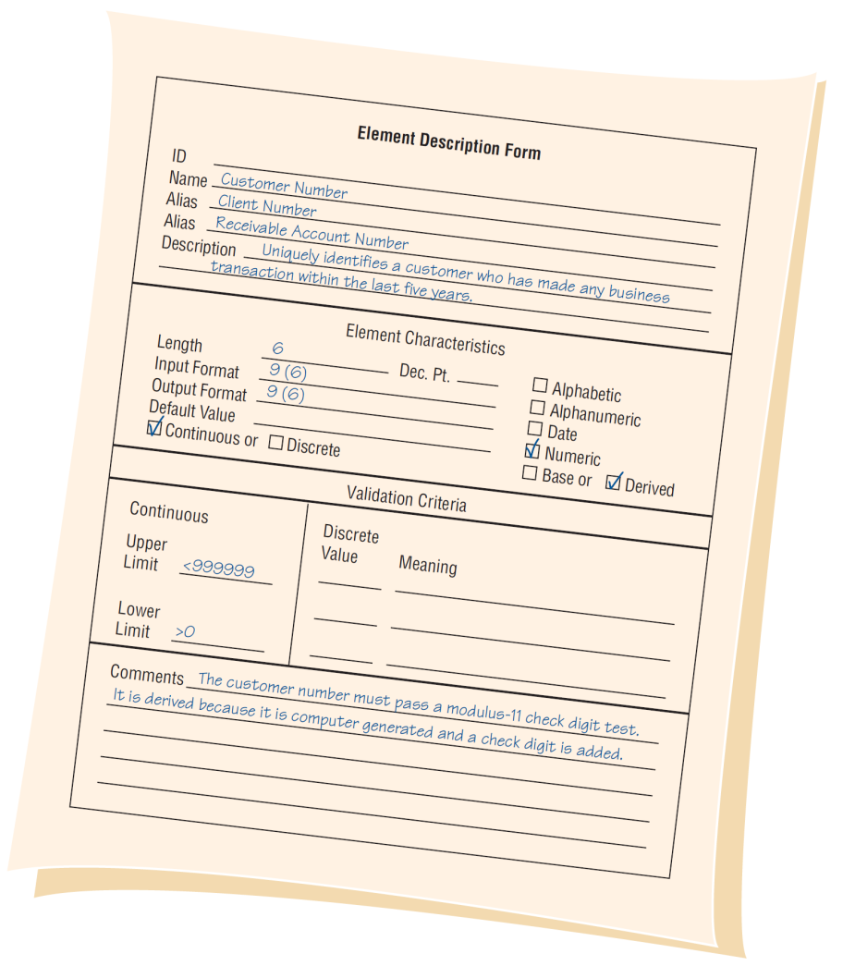
An Element Description Form Example from World’s Trend Catalog Division (Figure 8.6)
Kendall & Kendall Copyright © 2011 Pearson Education, Inc. Publishing as Prentice Hall
8-<number>
Notes:
Defined once in the data dictionary

Slide 21
Data Element Characteristics
Element ID
The name of the element
Aliases
A short description of the element
Element is base or derived
Element length
Type of data
Input and output formats
Validation criteria
Default value
An additional comment or remark area
Kendall & Kendall Copyright © 2011 Pearson Education, Inc. Publishing as Prentice Hall
8-<number>
Notes:
Element ID - This optional entry allows the analyst to build automated data dictionary entries.
The name of the element - descriptive and unique; It should be what the element is commonly called in most programs or by the major user of the element.
Aliases - which are synonyms or other names for the element; These are names used by different users within different systems.
Whether the element is base or derived –
A base element is one that has been initially keyed into the system.
A derived element is one that is created by a process, usually as the result of a calculation or some logic.
Type of data – alphanumeric or text data.

Slide 22
Element ID
Optional entry
Allows the analyst to build automated data dictionary entries
Kendall & Kendall Copyright © 2011 Pearson Education, Inc. Publishing as Prentice Hall
8-<number>

Slide 23
The Name of the Element
Should be:
  Descriptive
  Unique
Based on what the element is commonly called in most programs or by the major user of the element
Kendall & Kendall Copyright © 2011 Pearson Education, Inc. Publishing as Prentice Hall
8-<number>

Slide 24
Aliases
Synonyms or other names for the element
Names used by different users in different systems
A CUSTOMER NUMBER may also be called a RECEIVABLE ACCOUNT NUMBER or a CLIENT NUMBER.
Kendall & Kendall Copyright © 2011 Pearson Education, Inc. Publishing as Prentice Hall
8-<number>

Slide 25
Short Description of the Element
An example might be:
  Uniquely identifies a customer who has made any business transactions within the last five years
Kendall & Kendall Copyright © 2011 Pearson Education, Inc. Publishing as Prentice Hall
8-<number>

Slide 26
Element Is Base or Derived
A base element is one that has been initially keyed into the system.
A derived element is one that is created by a process, usually as the result of a calculation or a series of decision-making statements.
Kendall & Kendall Copyright © 2011 Pearson Education, Inc. Publishing as Prentice Hall
8-<number>

Slide 27
Element Length
What should the element length be?
  Some elements have standard lengths, state abbreviations, zip codes, or telephone numbers.
  For other elements, the length may vary and the analyst and user community must decide the final length.
Kendall & Kendall Copyright © 2011 Pearson Education, Inc. Publishing as Prentice Hall
8-<number>

Slide 28
Element Length Considerations
  Numeric amount lengths
  Name and address fields
  Other fields
Kendall & Kendall Copyright © 2011 Pearson Education, Inc. Publishing as Prentice Hall
8-<number>
Notes:
Numeric amount lengths - should be determined by figuring the largest number the amount will contain and then allowing room for expansion.
Totals should be large enough to accommodate the numbers accumulated into them.
Name and address fields – can be determined from a table.
Other fields – look at historical data found in the organization.

Slide 29
Name and Address Length
Percent of data that will
Element Length fit (United States)
Last Name 11 98
First Name 18 95
Company Name 20 95
Street 18 90
City 17 99
Kendall & Kendall Copyright © 2011 Pearson Education, Inc. Publishing as Prentice Hall
8-<number>
Notes:
A name field of 11 characters will accommodate 98 percent of the last names in the United States.

Slide 30
Data Truncation
If the element is too small, the data will be truncated.
The analyst must decide how this will affect the system outputs.
If a last name is truncated, mail would usually still be delivered.
A truncated email address or Web address is not usable.
Kendall & Kendall Copyright © 2011 Pearson Education, Inc. Publishing as Prentice Hall
8-<number>

Slide 31
Type of Data
Alphanumeric or text data
Formats
  Mainframe: packed, binary, display
  Microcomputer (PC) formats
  PC formats, such as Currency, Number, or Scientific, depend on how the data will be used
Kendall & Kendall Copyright © 2011 Pearson Education, Inc. Publishing as Prentice Hall
8-<number>
Notes:
Mainframe: packed, binary, display –
Zoned decimal – used for printing and displaying data
Packed decimal – commonly used to save space on file layouts and for elements that require a high level of arithmetic to be performed on them.
Binary – suitable for the same purposes as the packed decimal format but is less commonly used.

Slide 32
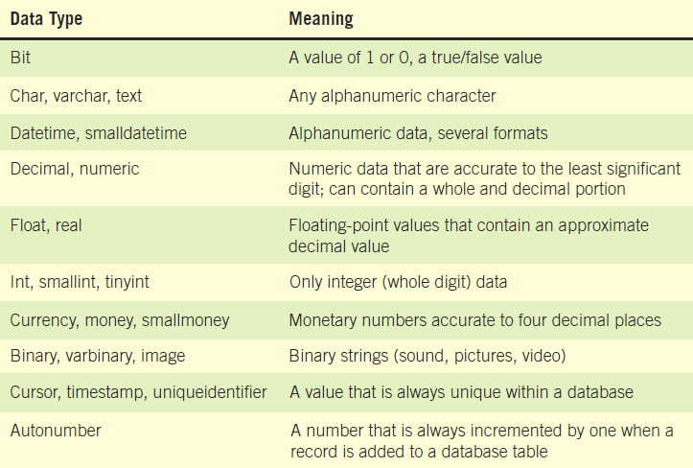
Some Examples of Data Formats Used in PC Systems (Figure 8.7)
Kendall & Kendall Copyright © 2011 Pearson Education, Inc. Publishing as Prentice Hall
8-<number>

Slide 33
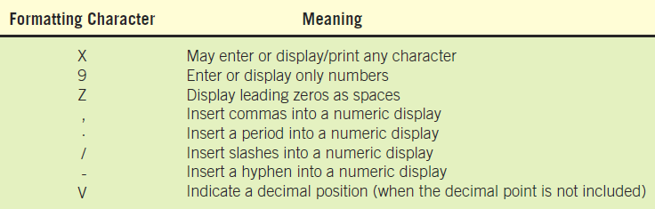
Format Character Codes
(Figure 8.8)
Kendall & Kendall Copyright © 2011 Pearson Education, Inc. Publishing as Prentice Hall
8-<number>
Notes:
Input and output formats should be included, using coding symbols:
Z - Zero suppress.
9 – Number.
X – Character.
X(8) - 8 characters.
. , - Comma, decimal point, hyphen.
These may translate into masks used to define database fields.

Slide 34
Validation Criteria
Ensure that accurate data are captured by the system
Elements are either:
  Discrete, meaning they have fixed values
  Continuous, with a smooth range of values
Kendall & Kendall Copyright © 2011 Pearson Education, Inc. Publishing as Prentice Hall
8-<number>
Notes:
Discrete –
Discrete elements are verified by checking the values within a program.
They may search a table of codes.
Continuous –
Continuous elements are checked that the data is within limits or ranges.

Slide 35
Default Value
Include any default value the element may have
The default value is displayed on entry screens.
Reduces the amount of keying
  Default values on GUI screens
    Initially display in drop-down lists
    Are selected when a group of radio buttons are used
Kendall & Kendall Copyright © 2011 Pearson Education, Inc. Publishing as Prentice Hall
8-<number>

Slide 36
Comment or Remarks Area
This might be used to indicate the format of the date, special validation that is required, the check-digit method used, and so on
Kendall & Kendall Copyright © 2011 Pearson Education, Inc. Publishing as Prentice Hall
8-<number>

Slide 37
Data Stores
Data stores are created for each different data entity being stored.
When data flow base elements are grouped together to form a structural record, a data store is created for each unique structural record.
Because a given data flow may only show part of the collective data that a structural record contains, many different data flow structures may need to be examined to arrive at a complete data store description.
Kendall & Kendall Copyright © 2011 Pearson Education, Inc. Publishing as Prentice Hall
8-<number>
Notes:
Data stores are created for each different data entity being stored - All base elements must be stored in the system. Derived elements may also be stored in the system.

Slide 38
Describing the Data Store
The data store ID
The data store name
An alias for the table
A short description of the data store
The file type
File format
Kendall & Kendall Copyright © 2011 Pearson Education, Inc. Publishing as Prentice Hall
8-<number>
Notes:
The Data Store ID – often mandatory to prevent the analyst from storing redundant information.
The Data Store Name - descriptive and unique.
An Alias for the table – such as CLIENT MASTER for the CUSTOMER MASTER.
The file type - computer or manual.
File format - Database table or flat file.

Slide 39
Describing the Data Store (Continued)
The maximum and average number of records on the file as well as the growth per year
The file or data set name specifies the file name, if known.
The data structure should use a name found in the data dictionary.
Primary and secondary keys
Comments
Kendall & Kendall Copyright © 2011 Pearson Education, Inc. Publishing as Prentice Hall
8-<number>
Notes:
The maximum and average number of records on the file as well as the growth per year – helps the analyst to predict the amount of disk space required for the application, necessary for hardware acquisition planning.
The file or data set name specifies the file name, if known – in the initial stages this item may be left blank.
The data structure should use a name found in the data dictionary – provides a link to the elements for this data store.
Primary and secondary keys – must be elements (or a combination of elements) found in the data structure.
primary key should be unique
secondary key is used to control record sequencing on reports and to locate records directly.
Comments – used for information that does not fit into any of the above categories; update or backup timing, security and so on.

Slide 40
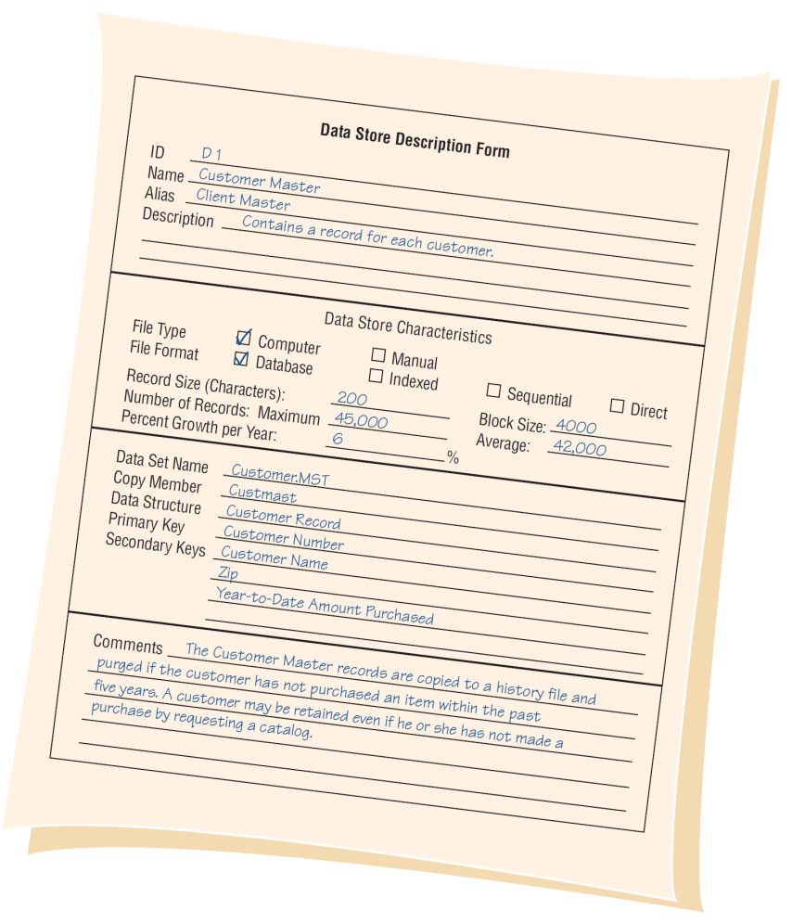
Example of a Data Store Form for World’s Trend Catalog Division (Figure 8.9)
Kendall & Kendall Copyright © 2011 Pearson Education, Inc. Publishing as Prentice Hall
8-<number>

Slide 41
Creating the Data Dictionary
Data dictionary entries
  Created after the data flow diagram is completed or
  Created as the data flow diagram is being developed
Created using a top-down approach
Kendall & Kendall Copyright © 2011 Pearson Education, Inc. Publishing as Prentice Hall
8-<number>
Notes:
The use of algebraic notation and structural records allows the analyst to develop the data dictionary and the data flow diagrams using a top-down approach.

Slide 42
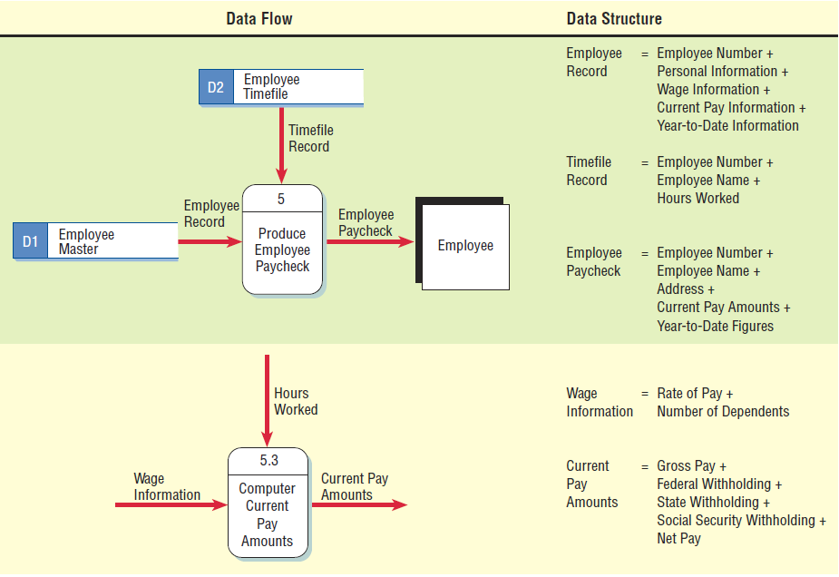
Two Data Flow Diagrams and Corresponding Data Dictionary Entries for Producing an Employee Paycheck (Figure 8.11)
Kendall & Kendall Copyright © 2011 Pearson Education, Inc. Publishing as Prentice Hall
8-<number>
Notes:
It is important that he data flow names on the child data flow diagram are contained as elements or structural records in the data flow on the parent process. i.e. WAGE INFORMATION is a structural record contained in the EMPLOYEE RECORD.

Slide 43
Analyzing Input and Output
A descriptive name for the input or output
The user contact responsible
Whether the data is input or output
The format of the data flow
Elements indicating the sequence of the data on a report or screen
A list of elements
Kendall & Kendall Copyright © 2011 Pearson Education, Inc. Publishing as Prentice Hall
8-<number>
Notes:
An important step in creating the data dictionary is to identify and categorize system input and output data flow.
A descriptive name for the input or output – if the data flow is on a logical diagram, the name should identify what the data are for, if on the physical design the names should include that information regarding the format.
The user contact responsible – for further details clarification, design, feedback, and final approval.
The format of the data flow – in the logical design stage the format may be undetermined.
A list of elements – including their names, lengths, and whether they are base or derived, and their editing criteria.

Slide 44
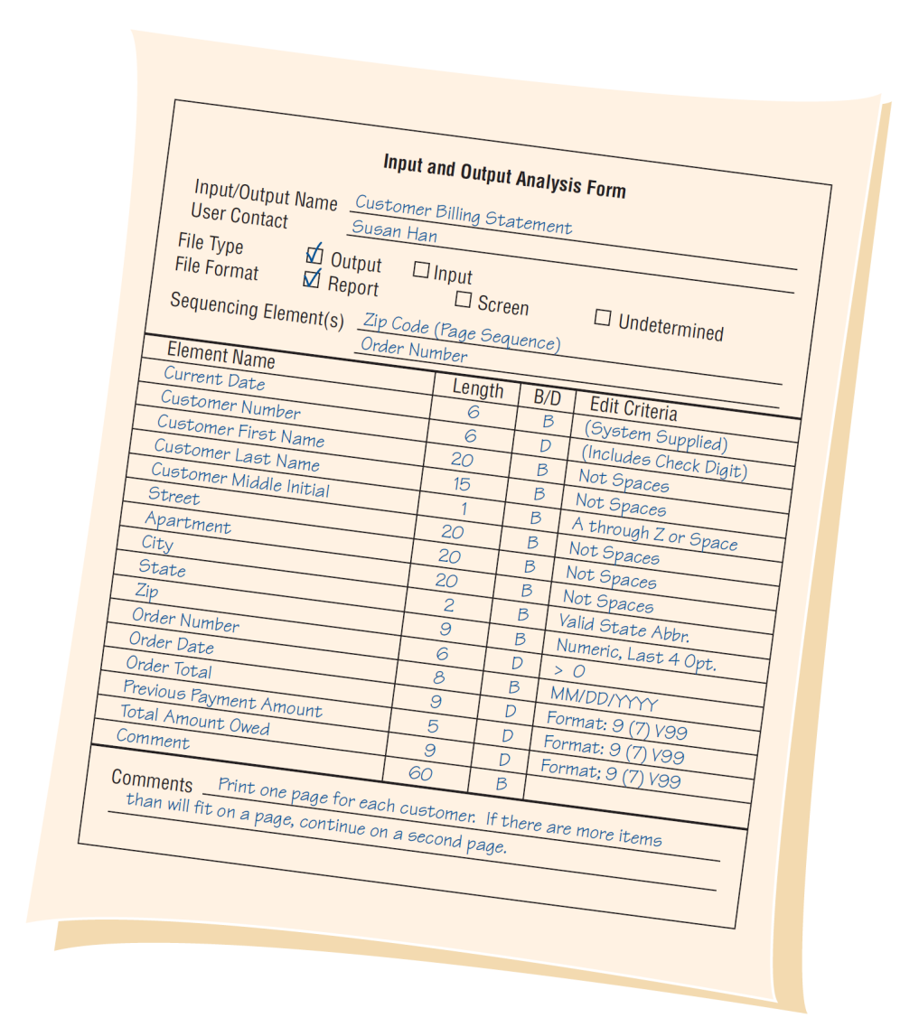
An Example of an Input/Output Analysis Form for World’s Trend Catalog Division (Figure 8.12)
Kendall & Kendall Copyright © 2011 Pearson Education, Inc. Publishing as Prentice Hall
8-<number>
Notes:
Once the forma has been completed, each element should be analyzed to determine whether the element repeats, whether it is optional, or whether it is mutually exclusive of another element.

Slide 45
Developing Data Stores
Represent data at rest.
Contain information of a permanent or semipermanent (temporary) nature.
When data stores are created for only one report or screen, we refer to them as “user views”.
Kendall & Kendall Copyright © 2011 Pearson Education, Inc. Publishing as Prentice Hall
8-<number>
Notes:
Derived values do not have to be stored in a data store.
“user views” – the way the user wants to see the information.

Slide 46
Using the Data Dictionary
To have maximum power, the data dictionary should be tied into a number of systems programs.
May be used to
  Create screens, reports, and forms
  Generate computer language source code
  Analyze the system design, detecting flaws and areas that need clarification
Kendall & Kendall Copyright © 2011 Pearson Education, Inc. Publishing as Prentice Hall
8-<number>
Notes:
The ideal data dictionary is automated, interactive, online, and evolutionary.
To have maximum power, the data dictionary should be tied into a number of systems programs – so that when an item is updated or deleted from the data dictionary, it is automatically updated or deleted from the database.

Slide 47
Create Screens, Reports, and Forms
Use the element definition and their lengths.
Arrange the elements in a pleasing and functional way using design guidelines and common sense.
Repeating groups become columns.
Structural records are grouped together on the screen, report, or form.
Kendall & Kendall Copyright © 2011 Pearson Education, Inc. Publishing as Prentice Hall
8-<number>

Slide 48
Analyze the System Design, Detecting Flaws and Areas that Need Clarification
All base elements on an output data flow must be present on an input data flow to the process producing the output.
A derived element should be created by a process and should be output from at least one process into which it is not input.
The elements that are present in a data flow coming into or going out of a data store must be contained in the data store.
Kendall & Kendall Copyright © 2011 Pearson Education, Inc. Publishing as Prentice Hall
8-<number>
Notes:
All base elements on an output data flow must be present on an input data flow to the process producing the output – base elements are keyed and should never be created by a process.
The data dictionary is the one common source in the organization for answering questions and settling disputes about any aspect of data definition.

Slide 49
Using Data Dictionaries to Create XML
XML is used to exchange data between businesses.
XML addresses the problem of sharing data when users have different computer systems and software or different database management systems.
XML documents may be transformed into different output formats.
XML is a way to define, sort, filter, and translate data into a universal data language that can be used by anyone.
XML may be created from databases, a form, software programs, or keyed directly into a document, text editor, or XML entry program.
Kendall & Kendall Copyright © 2011 Pearson Education, Inc. Publishing as Prentice Hall
8-<number>
Notes:
XML is used to exchange data between businesses – or between systems within a business.
If everyone used the same software or database management system, there would be no need for XML.
XML document may be transformed into different output formats – printed output, Web pages, output for a handheld device, and PDF files.
XML advantage
The analyst may select only the data that an internal department or external partner needs to have in order to function

Slide 50
Using Data Dictionaries to
Create XML (Continued)
The data dictionary is an ideal starting point for developing XML content.
A standard definition of the data is created using a set of tags that are included before and after each data element or structure.
XML elements may also include attributes.
The XML document tends to mirror the data dictionary structure.
Kendall & Kendall Copyright © 2011 Pearson Education, Inc. Publishing as Prentice Hall
8-<number>
Notes:
A standard definition of the data is created using a set of tags that are included before and after each data element or structure – the tags become the metadata, or data bout the data.
XML elements may also include attributes – an additional piece of data included within the tag that describes something about the XML element.

Slide 51
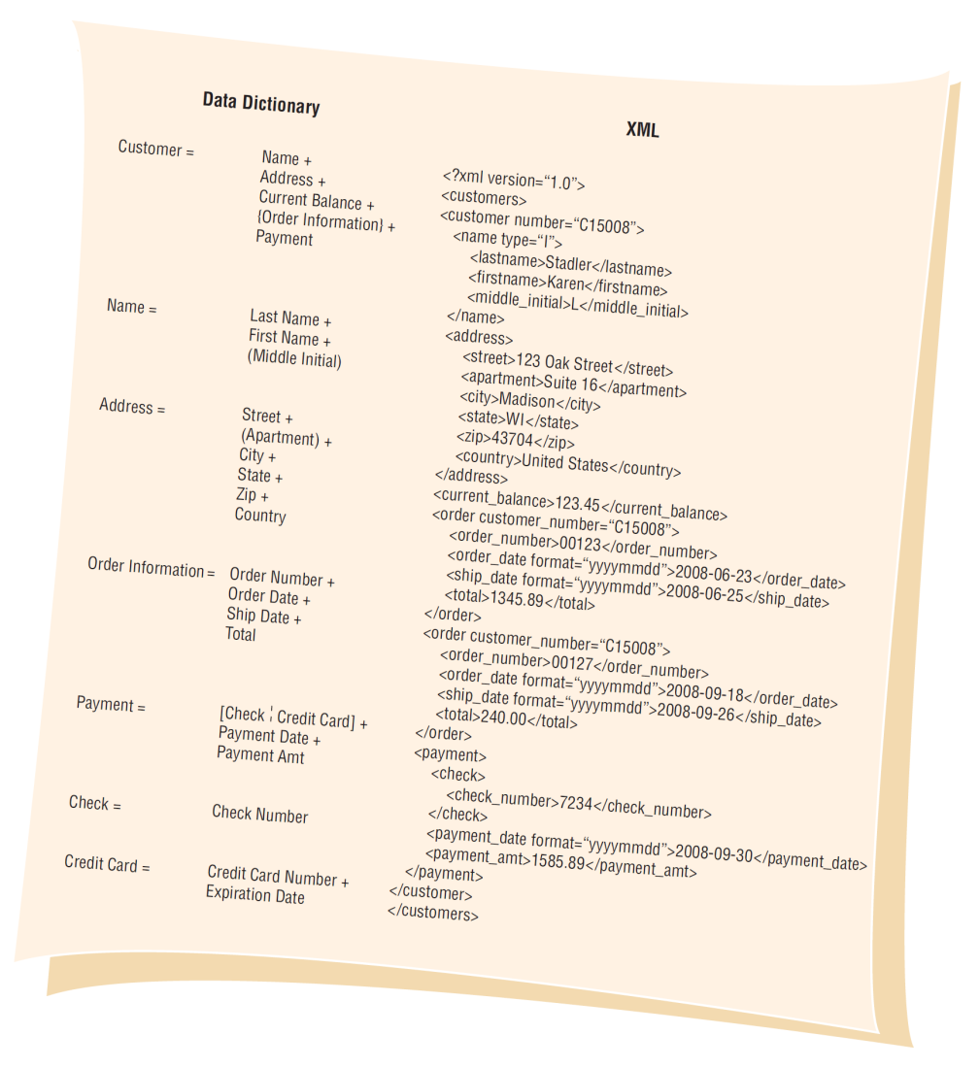
Using a Data Dictionary Entry to Develop XML Content: The XML Document Mirrors the Data Dictionary Structure (Figure 8.16)
Kendall & Kendall Copyright © 2011 Pearson Education, Inc. Publishing as Prentice Hall
8-<number>

Slide 52
XML Document Type Definitions
Used to determine if the XML document content is valid
DTDs may be created using the data dictionary.
DTD may be used to validate the XML document.
Kendall & Kendall Copyright © 2011 Pearson Education, Inc. Publishing as Prentice Hall
8-<number>
Notes:
Used to determine if the XML document content is valid – does it conform to the order and type of data that must be present in the document.
DTD’s may be created using the data dictionary – since the analyst has worked with users and made decisions on the structure of the data.
DTD may be used to validate the XML document – using standard XML tools.

Slide 53
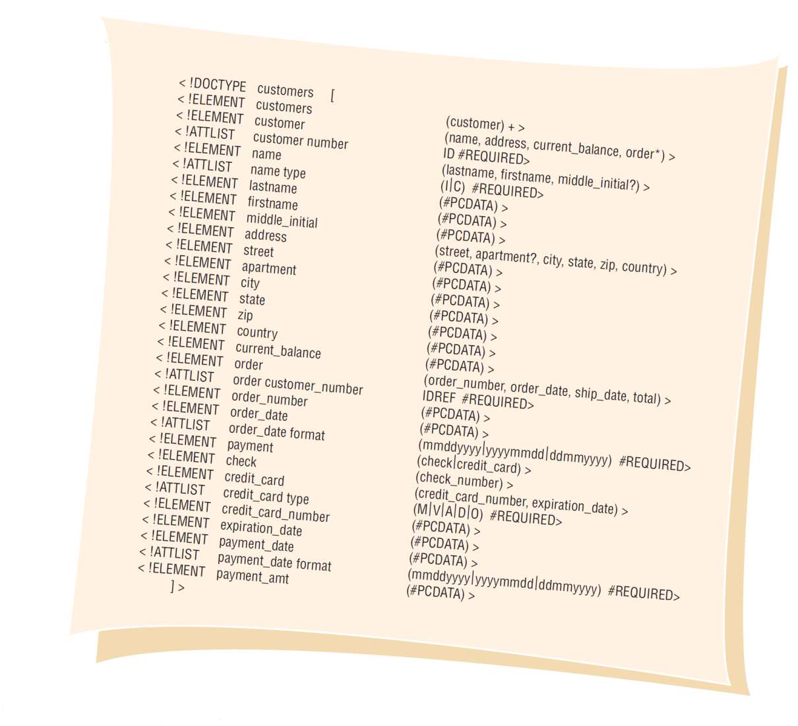
A Document Type Definition for the Customer XML Document (Figure 8.17)
Kendall & Kendall Copyright © 2011 Pearson Education, Inc. Publishing as Prentice Hall
8-<number>

Slide 54
XML Schemas
A more precise way to define the content of an XML document
Includes exact number of times an element may occur
Includes type of data within elements
Kendall & Kendall Copyright © 2011 Pearson Education, Inc. Publishing as Prentice Hall
8-<number>
Notes:
Includes type of data within elements – character or numeric values, including length of the elements, limits on the data and the number of places to the left and right of the decimal number.

Slide 55
Summary
The data dictionary
  A reference work containing data about data
  Includes all data items from data flow diagrams
Repository
  A larger collection of project information
Defining data structures
Defining elements
Kendall & Kendall Copyright © 2011 Pearson Education, Inc. Publishing as Prentice Hall
8-<number>

Slide 56
Summary (Continued)
Defining data stores
Data dictionary entries
Using the data dictionary
Data dictionary analysis
Data dictionary to XML
Kendall & Kendall Copyright © 2011 Pearson Education, Inc. Publishing as Prentice Hall
8-<number>

